Slide 1
Module 1
Case Study of Google Play App Data
By: Alex and Erica

Slide 2
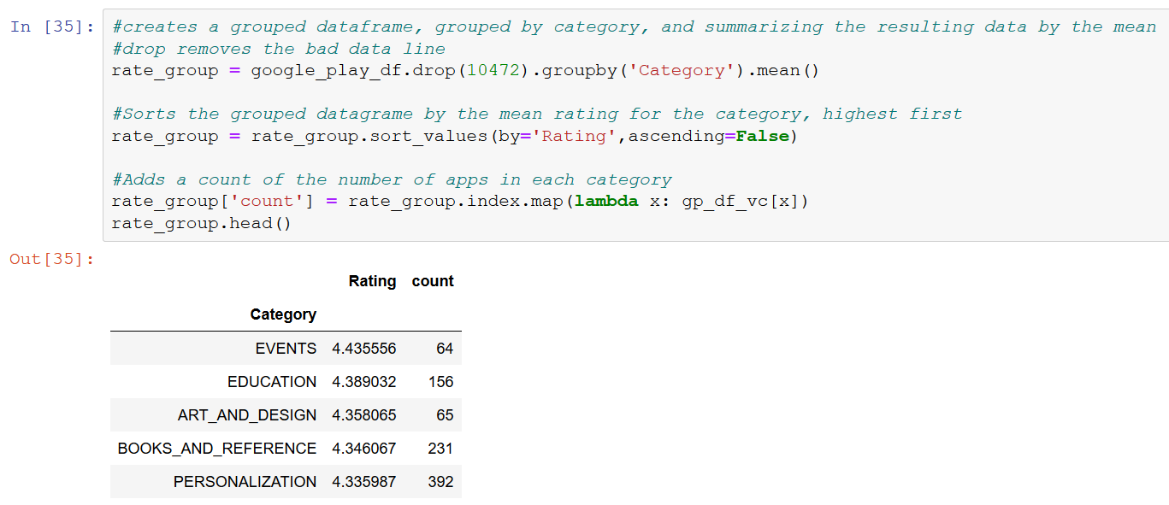
Question 1

Slide 3
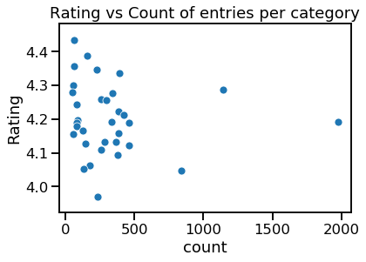
Correlation coefficient
= -0.100209

Slide 4
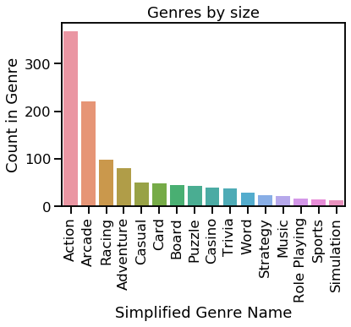

Slide 5
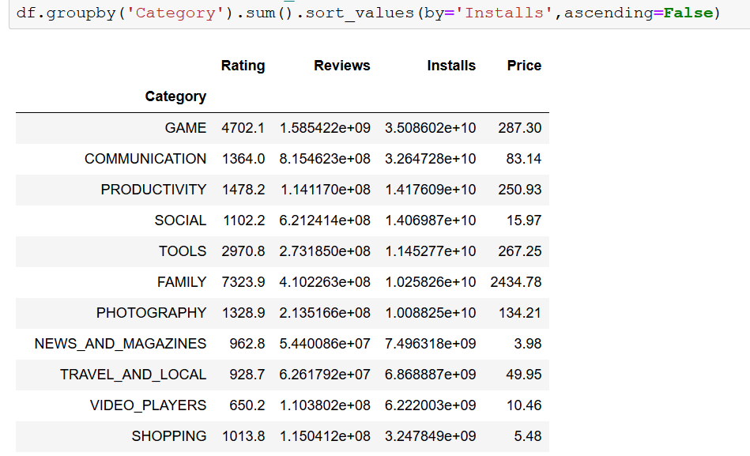

Slide 6
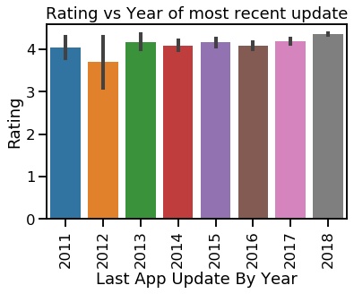
Interesting Insights
2012 had the lowest app ratings and was also the year that Google Play Launched and Formerly replacer Android Market.
In 2016, the ratings staggered once again. 2016 was the year that Google Play, moves the Google Play store and all android apps to the chrome OS

